Slide 1

STA324 The Foundations and Applications of Large Language Models
2025-2026 Spring Semester
Linyi Yang
Lecture 2 2026/01/19

Slide 2
Recap: What We Learnt and What Left?
Chapter 1
Chapter 2
Chapter 3
Chapter 4
In-context Learning
Introduction of LLM
Tokenization & Arch
GPUs
Chapter 5
Chapter 6
Chapter 7
Chapter 8
Mixture of Experts
Training Techniques
Advanced Training
Alignment
Chapter 9
Chapter 10
Chapter 11
Chapter 12
5.1休息
LLM Eval
Agent
Agent Eval
AI for Science
Guest Lecturer:
Research Scientist from Huawei
Lecture 6

Slide 3
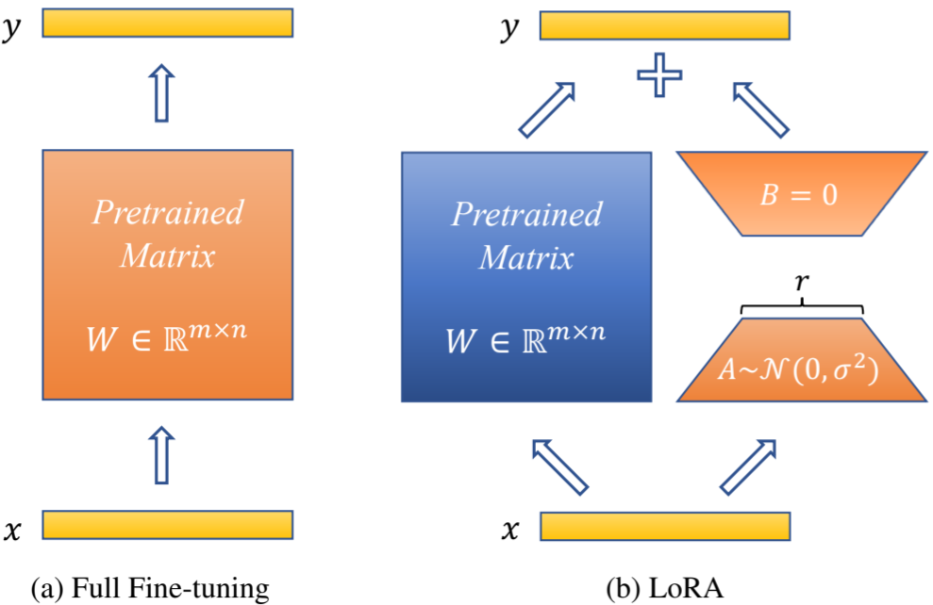
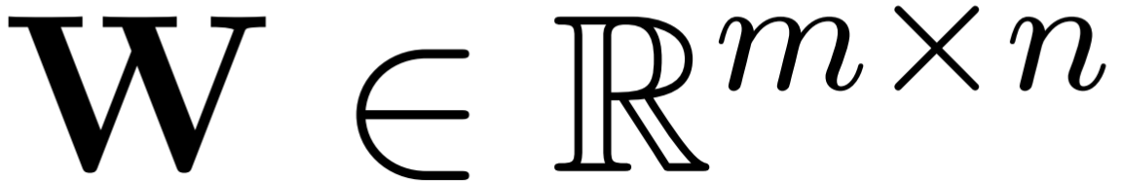
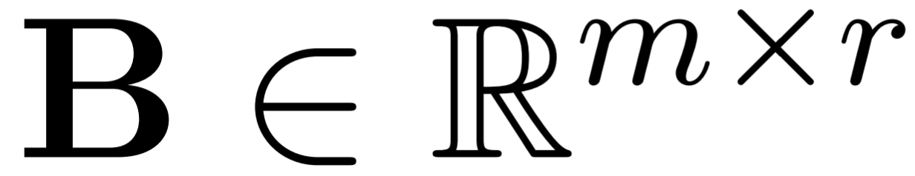
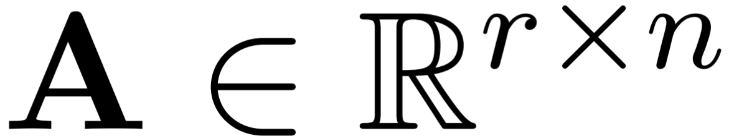
Recap: LoRA
Why Lora?
Low-Rank Adaptation (LoRA) has emerged as the mainstream alternative to Full Fine-tuning.
Hypothesis:
The weight updates during fine-tuning exhibit a low “intrinsic rank”. LoRA approximates the updated parameters using the product of two smaller matrices.
Forward Pass Formulation:
Hu, Edward J., et al. "Lora: Low-rank adaptation of large language models." ICLR (2022)
Lecture 6
Notes:
除LoRA 外，也有其他高效微调方法，如微调适配器（Adapter）或前缀微调（Prefix Tuning）。微调适配器分别对Transformer 层中的自注意力模块与多层感知（MLP）模块，以及MLP 模块与残差连接之间添加适配器层（Adapter layer）作为可训练参数[150]，该方法及其变体会增加网络的深度，从而在模型推理时带来额外的时间开销。
为什么微软的科学家能想到 LoRA？这源于他们对神经网络的一个极其敏锐的直觉：“低内在秩（low intrinsic rank）”。
大模型的参数量动辄千亿，看似极其复杂，但当它在学习某一个特定的下游小任务（比如写周报、模仿某个角色的语气）时，真正需要发生改变的参数空间维度，其实非常低。不需要重塑整个大脑，只需动用极少部分“脑细胞”就够了。
第二步：精妙的旁路设计（看右侧对比图）
既然不需要动全身，工程上该怎么实现呢？
（a）全量微调： 以前我们微调，是把输入 x 乘上原来的大矩阵 W，然后直接去修改整个大矩阵。这个 W 包含了成百上千亿的参数，全量更新不仅极慢，而且极度消耗显卡内存。
（b）LoRA 微调： 魔法就在这里。我们直接把原来庞大的蓝色砖块（Pretrained Matrix W）**“上锁冻结”**掉，不允许它更新了。然后，我们在它旁边架设一条“旁路（Bypass）”，用两个极其袖珍的矩阵 A 和 B 来模拟原本那庞大的更新量。
下一页有一个例子来比较。
第三步：大家看底部的核心公式：h = Wx + BAx。
原本，我们需要计算并保存一个和原本模型一样庞大的更新矩阵 \Delta W（维度是 m \times n）。
但在 LoRA 中，我们把 \Delta W 强行拆解成了两个小矩阵的乘积：\Delta W = BA。
矩阵 A 负责把高维输入“压缩”到一个极低的维度 r（维度 r \times n）。
矩阵 B 负责把这个低维度 r 重新“放大”回原本的维度（维度 m \times r）。
这里的 r 就是所谓的“秩（Rank）”。在工程实践中，r 往往设置得非常小（比如 4、8 或 16）。
这带来的参数量锐减是震撼的：你要更新的参数量瞬间从 m \times n 暴降到了 r \times (m + n)。
LoRA 就像是给大模型外挂了一个极其轻量级的“U盘”。大脑本体完全不动，学到的新知识全通过降维压缩存在 U 盘里。这就是为什么大家用一张普通的消费级游戏显卡，也能微调参数量相对较大的大模型。

Slide 4
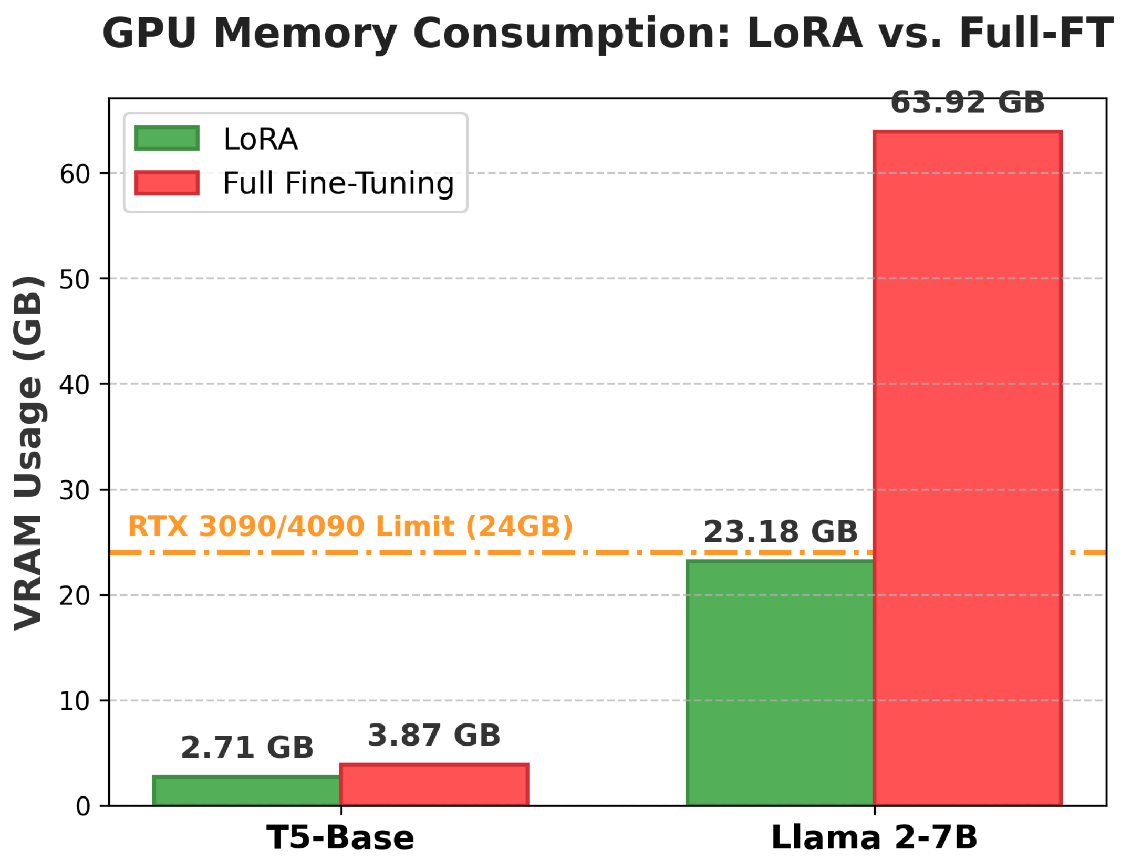
Recap: Examples of LoRA
Example: r = 8, m = n = 2048:
(m, n是模型参数矩阵的维度，r 是降维的 rank)
Full Fine-Tuning (m * n): 2048 * 2048 ~ 4.2M trainable parameters.
LoRA (r * (m +n)): 8 * (2048 + 2048) ~ 0.032M trainable parameters.
Conclusion: Only trains ~ 0.07% of the original parameters!
LoRA enables fine-tuning of 7B-class LLMs strictly within the memory limits of a single 24GB consumer GPU (e.g., RTX 3090/4090).
Lecture 6
Notes:
同学们好。刚才我们在黑板上推导了 LoRA 的数学原理，现在我们把这些枯燥的公式代入真实的数据，算一笔震撼的工程“经济账”。
这页 PPT 的核心逻辑，就是向大家展示 LoRA 是如何实现**“大模型微调平民化”**的。我们分两笔账来看：
第一笔账：数学层面的降维打击（看左侧）
假设大模型里某一层神经网络的维度是 m = n = 2048。
如果按传统全量微调，我们需要更新的参数量是 m \times n，大约是 420万。
如果按 LoRA 微调，我们把秩 r 设为 8，需要更新的参数量变成 r \times (m + n)，算下来仅仅只有 3.2万。
LoRA 仅仅训练了原本参数量的 0.07%，就达到了几乎和全量微调相媲美的效果！
第二笔账：物理层面的阶级跨越（看右侧图表）
参数少了，最直接的后果就是显存消耗（VRAM Usage）暴降。这才是工业界最关心的数据。 大家重点盯住图表右侧的 Llama 2-7B 模型，以及那条至关重要的橙色虚线（24GB）：
如果你要对这个 70亿参数的模型做全量微调（红色柱子），它会一口气吃掉将近 64GB 的显存。这意味着什么？意味着你必须去租用极其昂贵的工业级显卡（比如一张十几万人民币的 A100）才能跑得动。
但如果我们开启 LoRA（绿色柱子），显存占用瞬间被压缩到了 23.18GB。
为什么 24GB 和 23.18GB 这两个数字如此伟大？
因为 24GB 正好是顶级家用游戏显卡（比如 RTX 3090 或 4090）的物理显存上限。LoRA 极其精妙地将微调的门槛，从“昂贵的超算中心”拉低到了“普通大学生的宿舍”和“独立开发者的卧室”。
一句话总结：
这页 PPT 告诉我们，LoRA 的伟大之处不仅在于算法的精巧，更在于它彻底打破了算力垄断，让任何拥有一张高端游戏显卡的普通人，都有资格拥抱并改造百亿参数的通用大模型。

Slide 5
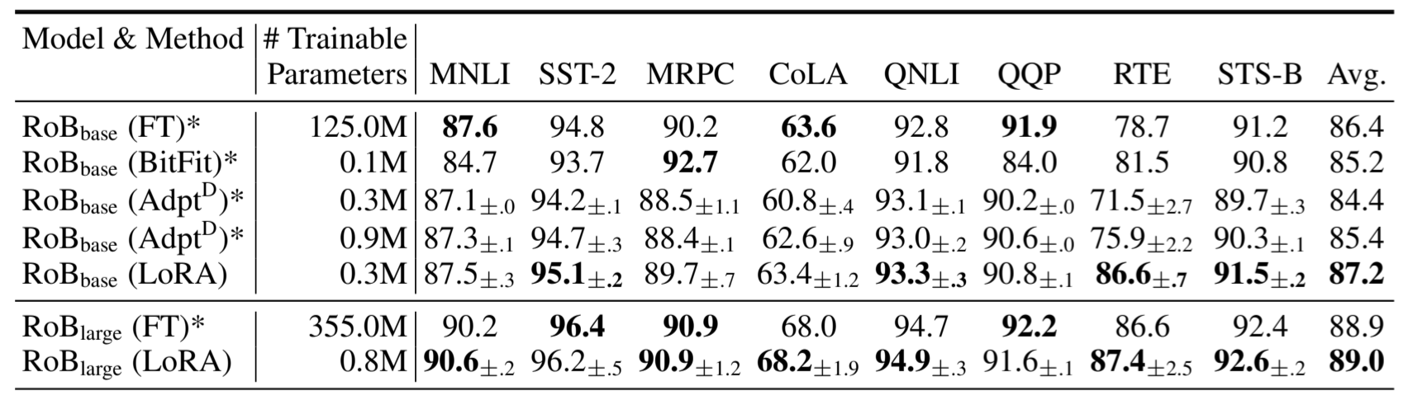
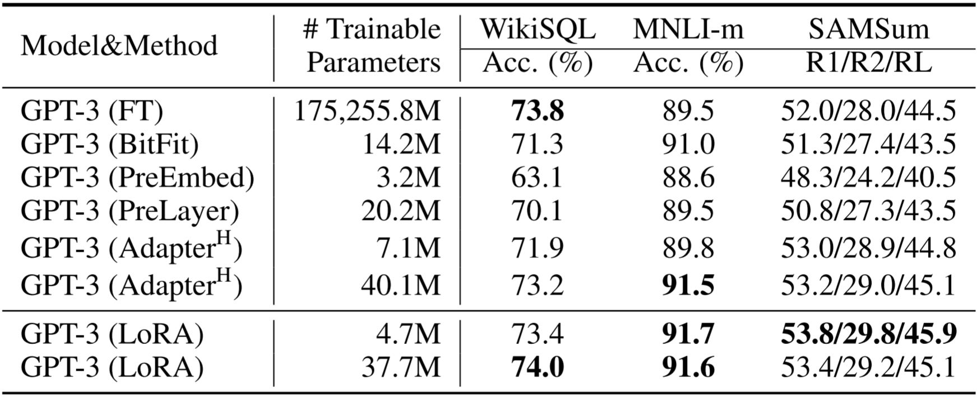
Recap: Performance of LoRA
Massive Parameter Reduction: Drastically cuts trainable parameters (e.g., reducing GPT-3 from 175B to just 4.7M).
Superior Performance:
Matches or even outperforms Full Fine-Tuning across diverse benchmarks.
Interested in more?
Explore advanced variants and evolutions like QLoRA, PiSSA, and HydraLoRA.
Hu, Edward J., et al. "Lora: Low-rank adaptation of large language models." ICLR (2022)
Lecture 6
Notes:
我们需要用真实的数据来回答一个最核心的质疑：“走捷径，会不会牺牲模型的智商/性能表现？”
我们重点关注两个反直觉的学术结论：
第一，极端的工程效率（参数量断崖式下降） 大家把目光直接扫向右侧下方的 GPT-3 表格。 传统的全量微调（FT），需要暴力更新高达 1752亿（175,255.8M） 个参数。而在应用了 LoRA 之后，同样是微调 GPT-3，真正需要更新的参数量被死死压榨到了仅仅 470万（4.7M）。
这是几个数量级的抹零！
第二，违反直觉的卓越性能（不降反升） 参数砍掉那么多，模型变笨了吗？并没有。 大家看右侧上方 RoBERTa 模型的评测表，看最后一列的平均分（Avg.）。全量微调（FT）的得分是 86.4，而只更新了极少参数的 LoRA，不仅没有掉分，反而拿到了更高的 87.2 分。 为什么会这样？从学术逻辑上来讲，全量更新庞大的参数矩阵，极其容易在下游的小数据集上产生过拟合（Over-fitting）。而 LoRA 这种低秩约束的机制，天然自带一种**正则化（Regularization）**的效果，反而保留了基座模型原本优秀的泛化能力。
最后，正因为 LoRA 在逻辑上的优雅和效率上的极致，它目前已经成为整个大模型微调领域的基石。大家看左下角，沿着它的思路，学术界后来又衍生出了量化版本的 QLoRA、基于奇异值分解的 PiSSA 等等，彻底点燃了开源社区的繁荣。

Slide 6
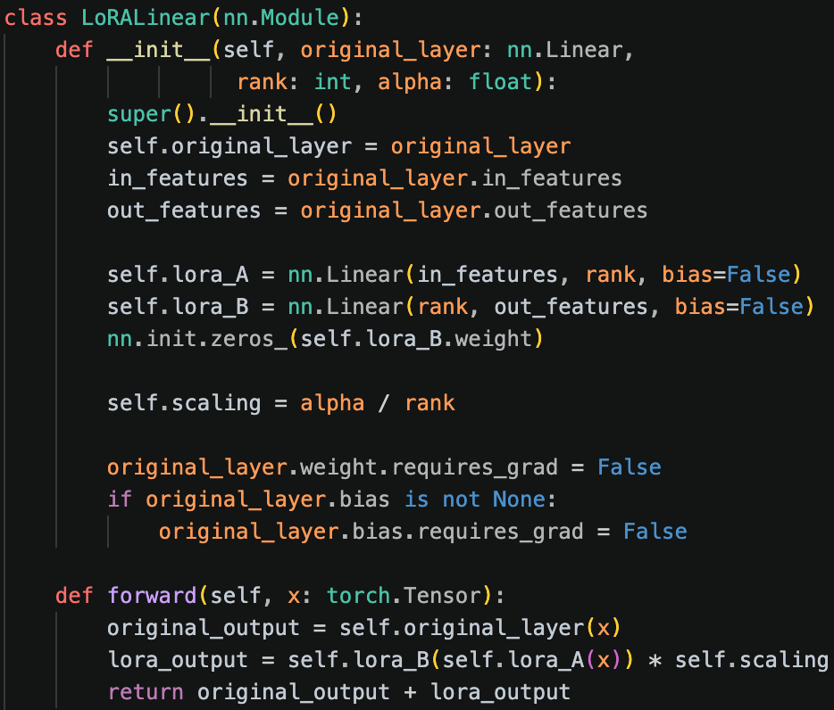
Recap: Code Implementation
Core Idea:
LoRA approximates the weight update of a full linear layer using two low-rank linear layers: a down-projection (lora_A) followed by an up-projection (lora_B).
Zero Initialization (lora_B):
Initialized with ZEROS so the model behaves exactly like the frozen base model at step zero.
Gradient Freezing:
requires_grad = False strictly locks the base model to save massive VRAM during backward pass.
Lecture 6
Notes:
同学们好。前面咱们推导了 LoRA 的数学原理，也算了它省下的“显存账本”。但这节课，我们要剥开理论的外衣，直接看最硬核的工程源码。
这页 PPT 展示的是 LoRA 核心模块在 PyTorch 中的极简实现。别看只有短短十几行代码，里面藏着三个极具工业级智慧的“神来之笔”。咱们顺着代码一行行看：
第一处神来之笔：冻结基座（Gradient Freezing）
大家看 __init__ 函数的下半部分，那两句极其霸道的代码：requires_grad = False。
这就是我们在代码层面给大模型“上锁”。它强行告诉深度学习框架：原来那个庞大的 original_layer 矩阵，在反向传播时绝对不允许计算梯度！正是这行不起眼的代码，替我们砍掉了 99% 的显存消耗。
第二处神来之笔：旁路降维（Core Idea）
基座冻住了，新知识怎么学？看中间定义 lora_A 和 lora_B 的地方。
lora_A 是一个**降维（down-projection）**矩阵，把高维的输入特征强行压缩到极其微小的 rank 维度。
lora_B 是一个**升维（up-projection）**矩阵，把微小维度再还原回输出维度。
这就相当于在被封死的主干道旁边，巧妙地修了一条极其轻量级的“辅路”。
第三处神来之笔：零初始化（Zero Initialization）
这是整段代码里最精妙的一处细节，大家看这句：nn.init.zeros_(self.lora_B.weight)。
为什么要把 lora_B 强行初始化为全 0？大家顺着逻辑想：因为 $B$ 是 0，所以在训练刚开始的第 0 步，这条辅路（$A \times B$）输出的增量结果必定是 0。
看最底下的 forward 前向传播函数：return original_output + lora_output。既然此时 lora_output 是 0，那么模型在接入 LoRA 的瞬间，它的表现和原版大模型绝对一模一样。这就保证了我们的微调是一个“平滑过渡”的过程，模型绝对不会因为接入了未经训练的随机参数而突然“变傻”。
一句话总结这页 PPT：
这十几行代码完美诠释了什么是“大道至简”。用 requires_grad = False 守住显存底线，用 A 和 B 矩阵打通学习的旁路，用“零初始化”保证初始状态的绝对安全。这就是顶级工程师将数学理论化为现实的暴力美学。

Slide 7
Outline
5 The Life Cycle of Large Language Models
5.4 Data Construction
5.5 DeepSpeed-Chat SFT
5.6 Model Distillation
Lecture 1

Slide 8
5.4 The Importance of Data: From Pre-training to Post Training
Peer into the data of some popular models
Lecture 7

Slide 9
5.4 The Important of Data: From Pre-training to Post Training
Mid-training + post-training: Focus on particular capabilities
Nemotron-CC-Math-v1
# Math Dataset Used for Mid-term Project
Nemotron-Competitive-Programming-v1
# Contains over 2M Python and 1M+ C++ samples from coding
competitions for supervised fine-tuning (SFT).
Nemotron-Agentic-v1
# Focuses on multi-turn conversations for tool use
and agentic AI scenarios.
Lecture 7

Slide 10
5.4 Nemotron-CC-Math-v1
Mid-term project will officially start from this week
Keep an eye on the blackboard
What’s in inside the Dataset:
How NVIDIA built it:
1. Lynx Rendering 2. LLM Cleaning 3. Quality Filtering 4. Deduplication 5. Decontamination
For your project, we sampled 100K input-output pairs from the dataset as the training set
https://huggingface.co/datasets/nvidia/Nemotron-CC-Math-v1
Lecture 7

Slide 11
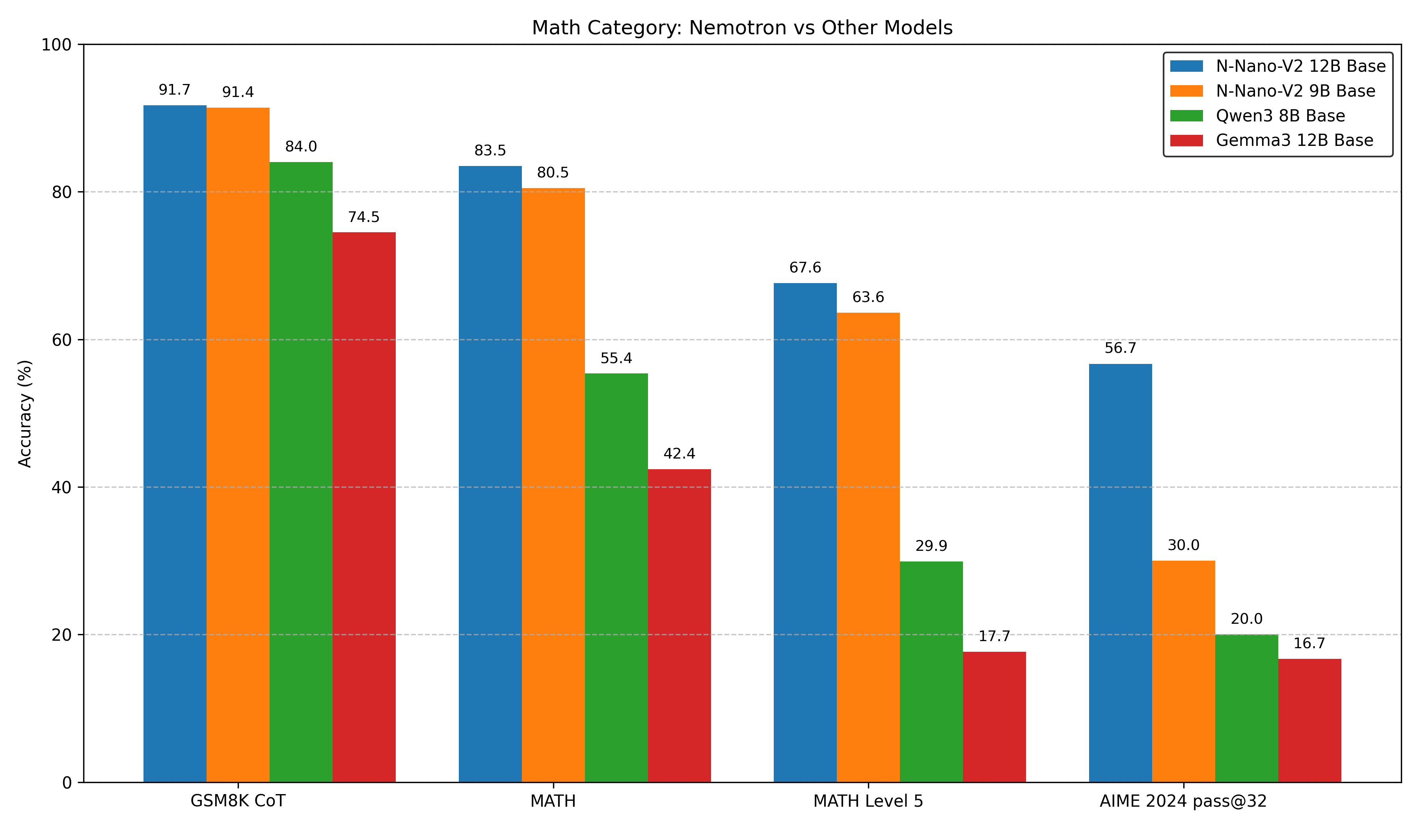
5.4 Performance for Math Pre-training
With Nemotron-CC-Math, we’re raising the bar for open math pre-training.
Lecture 7

Slide 12
5.4 Mid-training ablations
Nemotron-CC-Math dataset obtains substantial improvements across math, code, and general reasoning.
Dataset | MATH (EM) | GSM8K (EM) | HumanEval+ (average@20) | MBPP+ (average@20) | MMLU (EM) | MMLU-STEM (EM)
OpenWebMath | 34.2 | 76.42 | 33.54 | 37.59 | 65.20 | 59.20
FineMath-3+ | 34.6 | 79.45 | 34.18 | 29.19 | 67.92 | 62.29
MegaMath-Web | 31.6 | 78.24 | 32.29 | 38.89 | 65.44 | 59.88
Nemotron-CC-Math-3+ | 44.20 | 80.06 | 37.16 | 43.51 | 68.20 | 64.26
Lecture 7

Slide 13
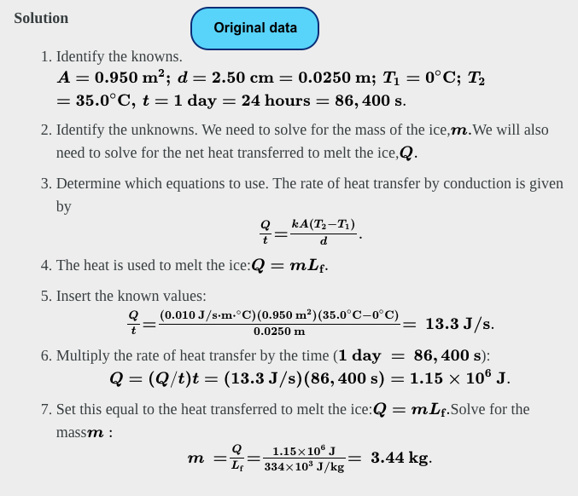
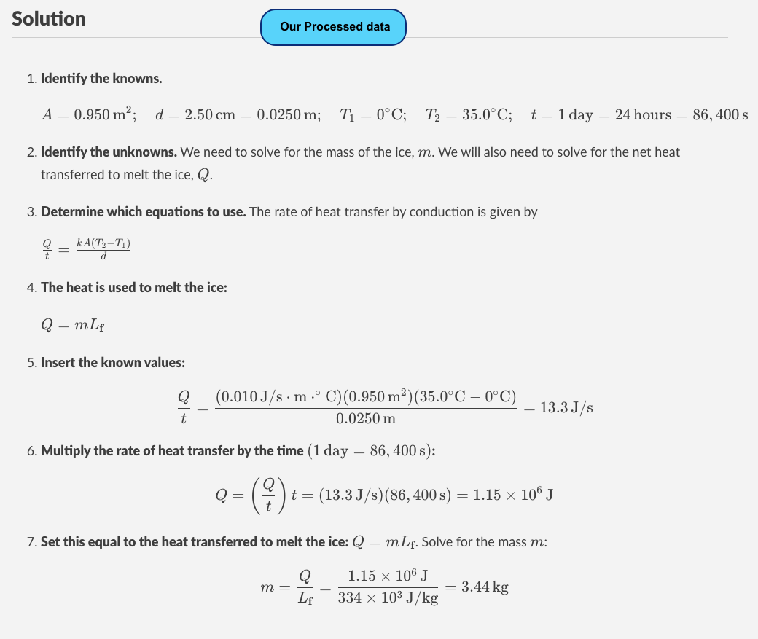
5.4 Nemotron-CC-Math-v1: Qualitative Examples
Original:
Processed Data:
Lecture 7

Slide 14
5.4 Summary
No free lunch: You have to clean the dataset before using.
Live service -> Raw data -> Processed data (conversion, filtering, deduplication)
Data is the key ingredient that differentiates LLMs
Legal and ethical issues (e.g., copyright and privacy)
Much of this pipeline is heuristic, many opportunities to improve! (The key in the Mid-term project)
Lecture 7

Slide 15
5.4 The Usage of Data in Different Stages
Pre-training: train on raw text (e.g., documents from the web)
Mid-training: train more on high quality data to enhance capabilities （中文：退火训练）
Post-training: fine-tune on instruction following data (or do reinforcement learning) for instruction following
In practice, the lines are blurry and there could be more stages.
Principles: Convert “Large amounts of lower quality data” to “small amounts of high quality data”
Terminology:
Base model: after pre-training + mid-training
-Instruct / -chat model: after post-training
Lecture 7

Slide 16
5.4 Examples: Pretraining
The results of Pre-training [OLMo, 2024]:
Lecture 7

Slide 17
5.4 Examples: Mid-training
The results of Mid-training:
Lecture 7

Slide 18
5.4 Examples: Post-Training
The results of Post-training:
Lecture 7

Slide 19
5.4 The First Attempt of SFT
Alpaca
Vicuna
Lecture 7

Slide 20
5.4 Alpaca vs. Vicuna
Lecture 7

Slide 21
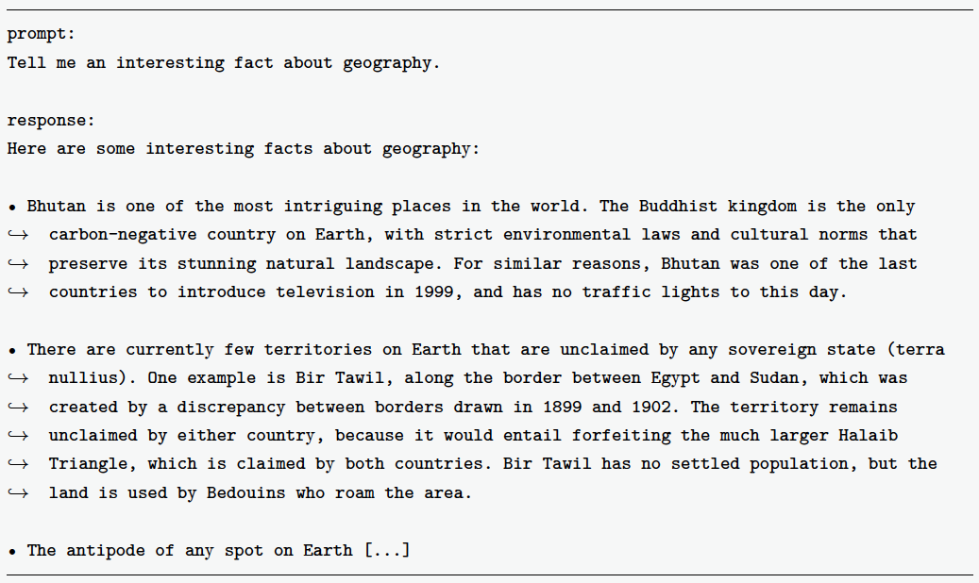
5.4 Manual Data Construction: Less is More (?)
LIMA / LIMO / LIMR (Less is more for Alignment, Reasoning, and RL)
The example of instruction data is as follows:
Lecture 7

Slide 22
5.4 Data Analysis
Types of data objects:
Live Service (e.g., Reddit)
Raw snapshot (via crawling or API or dumps)
Processed text (via various filtering and transformations)
Aggregated datasets (e.g., The Pile, C4, RedPajama-V2, FineWeb, FineWeb-Edu, and DCLM)
Sources of Data:
Annotators (e.g., Llama 2 instruction data)
Real users (e.g., ShareGPT – Share your chat history with LLMs)
Curated (from Common Crawl)
Distilled from stronger model (e.g., synthetic data from GPT-4)
Self-distillation (synthetic data from model you’re training)
https://huggingface.co/datasets/EleutherAI/pile
Lecture 7

Slide 23
5.4 LIMA: Data Resources
To ensure dataset diversity, LIMA samples instruction data from a range of sources, including high-quality online Q&A communities, the Super-Natural Instructions dataset, and a substantial corpus of manually authored prompts and responses.
The diversity of the resulting dataset is maintained through several key factors:
Topical Breadth: Online communities provide coverage across diverse sub-forums and subject matters.
Task Variety: The Super-Natural Instructions dataset contributes a wide array of generative tasks.
Inherent Variation: Manually authored entries naturally reflect the distinct perspectives and styles of individual annotators.
[LIMA, 2024] LIMA: Less Is More for Alignment. https://arxiv.org/abs/2305.11206
Lecture 7
Notes:
为了保证指令数据的多样性，LIMA 从多个来源采样收集指令数据，包括高质量网络问答社区、Super-Natural Instructions[160] 指令集，以及大量的标注者手动编写的提示与回答。
网络问答社区包含多个子版块，涵盖了不同的主题。
Super-Natural Instructions 指令集也包含了多种多样的生成式任务。
标注者各自编写的提示与回答具有天然的多样性，因此指令数据的多样性得到了很好的保障。

Slide 24
5.4 LIMA: Data Resources
LIMA prioritizes the quality of instruction data through a multi-staged refinement process. Initially, the selection of reputable data sources establishes a baseline for quality. Subsequently, specific heuristic rules are applied to further enhance the dataset:
Community Data Filtering: Selecting only top-ranked responses from community platforms.
Style Alignment: Standardizing all responses to reflect a consistent AI assistant persona.
Structural Pruning: Removing entries that are excessively long, excessively short, or contain external links.
Narrative Control: Eliminating responses written in the first person.
Manual Refinement: Utilizing expert annotators to craft high-quality, manual responses.
By utilizing only 1,000 high-quality samples, LIMA achieves performance comparable to, or exceeding, models of similar scale trained on datasets several orders of magnitude larger (几十倍大).
Lecture 7
Notes:
LIMA 做了大量的工作来保证指令数据的质量。
首先，指令数据来源的可靠已经在一定程度上保证了它的质量。
其次，LIMA 额外制定了一些规则进一步提高其质量。
例如，对社区指令数据采样时选择排名靠前的优质回答，将所有的回答统一成AI 助手的风格，删除过长或过短的回答，删除以第一人称开头的回答，删除包含链接的回答，标注者精心手动编写回答，等等。
LIMA 的实验结果说明指令数据的质量和多样性是影响有监督微调过程的关键因素。LIMA仅使用1 000 条这样的指令数据，就可以媲美甚至超过指令数据是其几十倍的同等参数规模的其他模型。
Experimental results indicate that quality and diversity are the primary determinants of effective Supervised Fine-Tuning (SFT). By utilizing only 1,000 high-quality samples, LIMA achieves performance comparable to, or exceeding, models of similar scale trained on datasets several orders of magnitude larger.

Slide 25
5.4 Add Capabilities of LLMs
Capabilities to add:
Solving fundamental NLP tasks (e.g., information extraction)
Instruction following and chat
Long contexts (e.g., 4096->100,000)
Infilling
Domain-specific capabilities (e.g., coding, math, etc.)
Safety (e.g., refusal)
Reasoning (e.g., chain of thought, arising from ChatGPT o1)
Lecture 7

Slide 26
5.4 Where to get the available dataset?
Who writes the content?
Anyone on the Internet can edit and write the data
Wikipedia
The specific-interest group
Common Crawl is a non-profit organization.
How to crawl the data?
Every ~month, run a web crawl
So far, there have been ~100 crawls from 2008-2025
In 2016, crawl takes 10-12 days on 100 machines
Crawls have some overlap but try to diversify
Lecture 7

Slide 27
5.4 Policies
Crawling Policies:
Selection policy: which pages to download?
Politeness policy: respect robots.txt, don’t overload server
Re-visit policy: how often to check if pages change
Challenge: URLs are dynamic, many URLs lead to basically same content
Two formats
WARC: raw HTTP response (e.g., HTML)
WET: converted to text (lossy process)
HTML to text
Tools to convert HTML to text
DCLM paper shows that the conversion matters for downstram task accuracy
Lecture 7

Slide 28
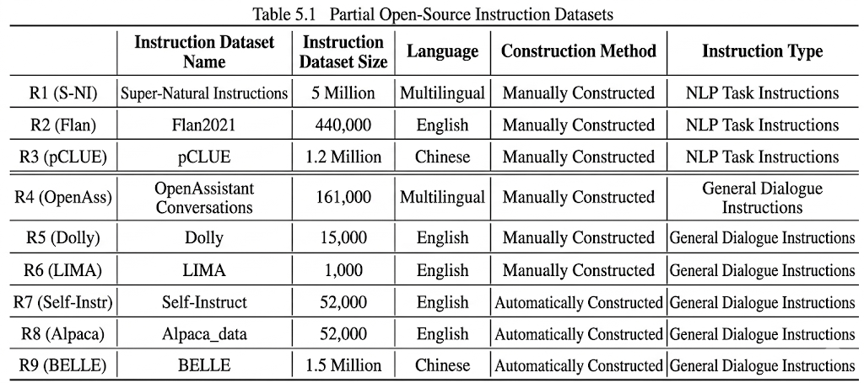
5.4 Open-source Instruction Datasets
Instruction datasets are of great significance for supervised fine-tuning.
Can be classified as manual and automatic constructions.
Can be categorized as NLP-based instructions and Chat-based instructions.
Lecture 7

Slide 29
Outline
5 The Life Cycle of Large Language Models
5.4 Data Construction
5.5 DeepSpeed-Chat SFT
5.6 Model Distillation
Lecture 1

Slide 30
5.5 DeepSpeed-Chat: Standard Post-Training Framework
ChatGPT-like models:
Step 0: Pretrained model
Step 1: Supervised Fine-Tuning (SFT)
RLHF:
Step 2: Reward Model (RM) Training
Step 3: Reinforcement Learning
Although we have learned the distributed training framework like Flash-attention / deepspeed, it is hard to combine them together.
DeepSpeed-Chat: An end-to-end system built on the DeepSpeed framework, provides a streamlined workflow for Step 1 -- Step2 -- Step3 .
Lecture 7

Slide 31
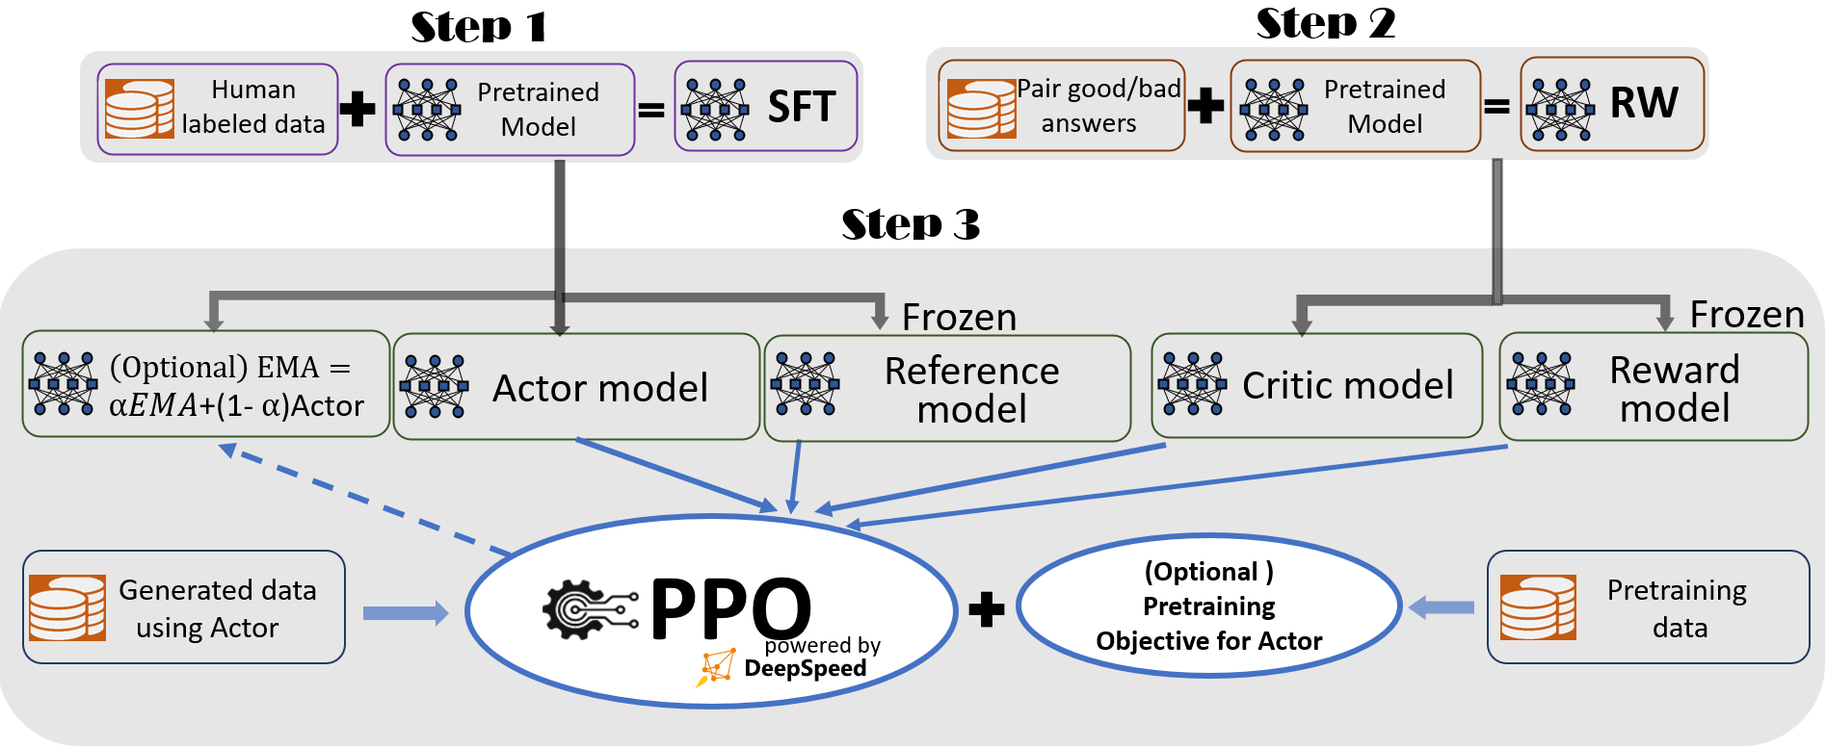
5.5 DeepSpeed-Chat: Standard Post-Training Framework
Core Capabilities of DeepSpeed-Chat
Easy-to-Use: Enables multi-step ChatGPT-style training and enhanced inference using a single script.
Pipeline: Reproduces the full training workflow and methodology established in the InstructGPT paper.
System: Integrates DeepSpeed’s high-performance Training Engine with its high-throughput Inference Engine.
Lecture 7

Slide 32
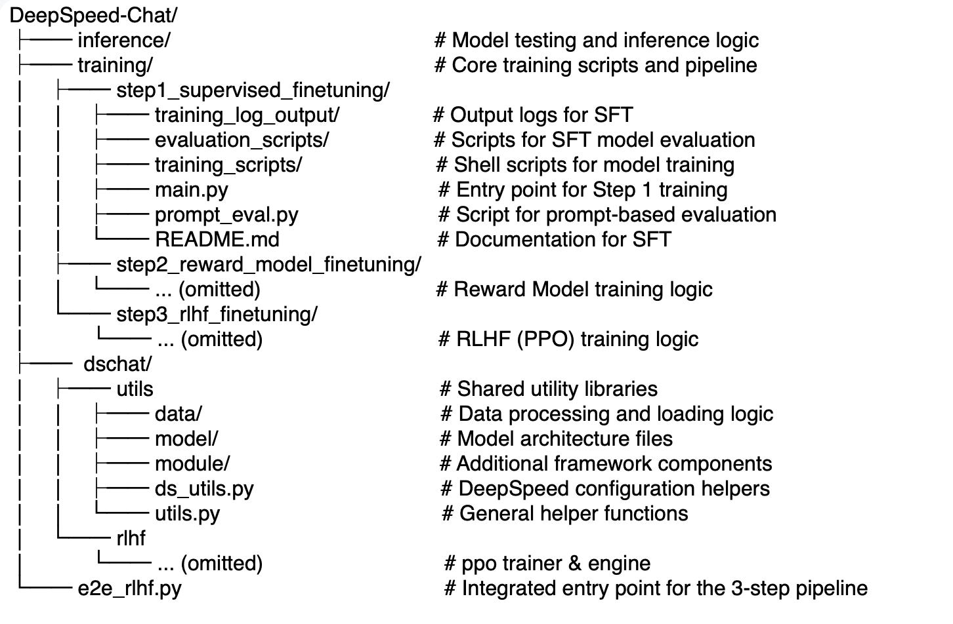
5.5 DeepSpeed-Chat: Code
https://github.com/deepspeedai/DeepSpeedExamples/tree/master/applications/DeepSpeed-Chat
Lecture 7

Slide 33
5.5 DeepSpeed-Chat: Configuration
Full steps fine-tuning in a script: using the e2e_rlhf.py with the following parameters
--step : Which steps of the ChatGPT example to run; default to all steps; can use --step 1 2
--deployment-type : Number of GPUs to run the actor/reward models on, e.g. "single_gpu” / "single_node” / "multi_node"
--actor-model : Which model to use for training (step 1)
--reward-model : Which model to use for reward model training (step2)
--actor-zero-stage : ZeRO stage for step 1 (Actor) training
--reward-zero-stage : ZeRO stage for step 2 (Critic) training
--output-dir : Directory for output of each step
Lecture 7

Slide 34
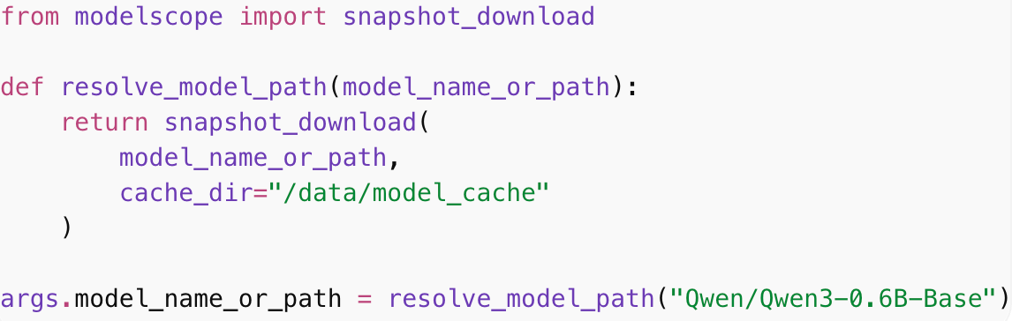
5.5 DeepSpeed-Chat: Change to Qwen-0.6B-Base
The Limitation: DeepSpeed-Chat defaults to LLaMA-2 7B, but we need qwen-0.6B-base as the pretrained model
DeepSpeed-Chat natively supports the HF format (also the ModelScope format):
update the model_name_or_path parameter in step-1 main.py
Lecture 7

Slide 35
5.5 DeepSpeed-Chat: Custom Data Processing
Integrating Custom Datasets
High-quality, task-specific data is critical for optimizing your own Large Language Models. To introduce new datasets into the DeepSpeed-Chat pipeline, follow these three steps:
Format the Data: Prepare and convert your dataset into a framework-compatible format, such as JSON.
Update Data Processing Logic: Modify the core data utilities (dachat/utils/data/raw_datasets.py and dachat/utils/data/data_utils.py) to parse and handle your specific dataset structure.
Modify Training Scripts: Update your training scripts to register and load the new dataset, then launch the model training.
Lecture 7

Slide 36
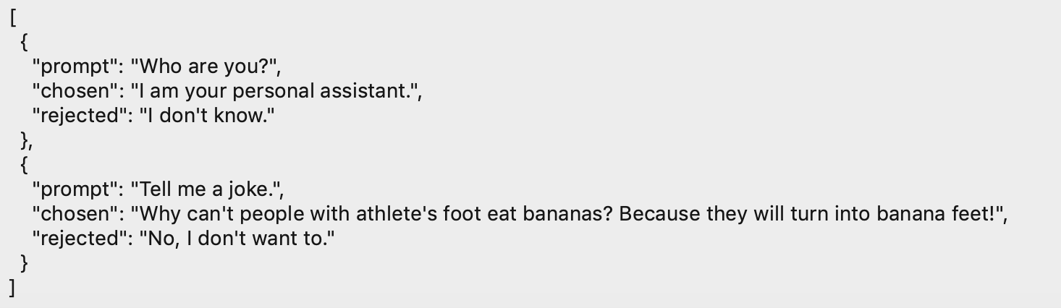
5.5 DeepSpeed-Chat: Examples
Example：
Step 1: using the prompt + chosen, where chosen is the label. The “rejected” item can be “”.
Step 2: using the prompt + chosen + rejected, where chosen & rejected is the pair data for reward model
Lecture 7

Slide 37
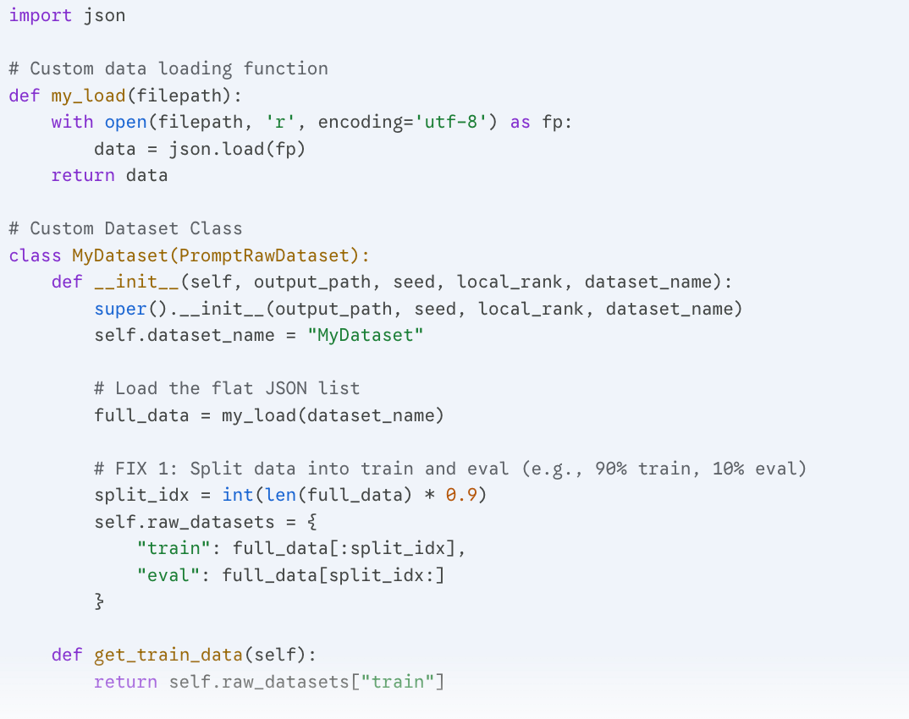
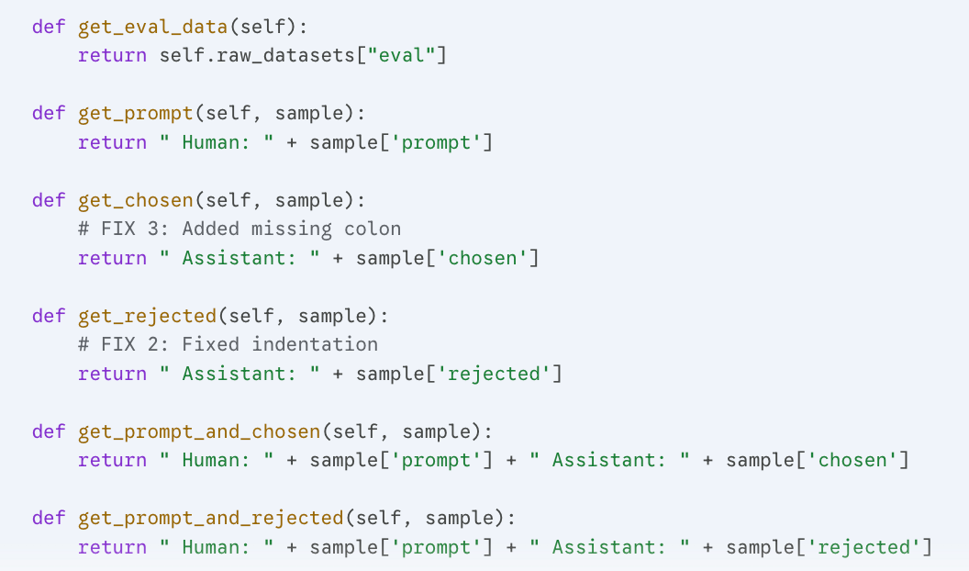
5.5 DeepSpeed-Chat: Data Preparation
Insert the following code into raw_datasets.py, where load(dataset_name) handles data loading.
Lecture 7

Slide 38
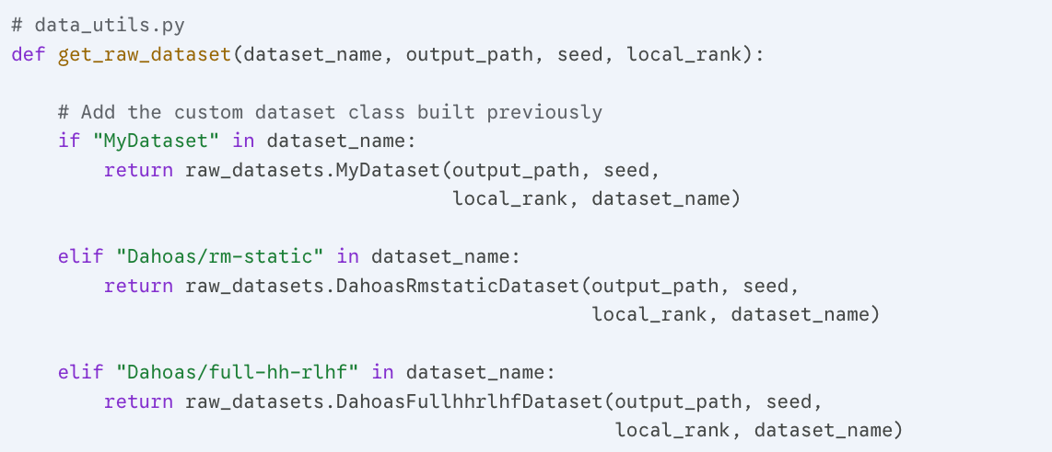
5.5 DeepSpeed-Chat: Data Preparation
Insert the following code into data_utils.py, where get_raw_dataset register our dataset class.
Lecture 7

Slide 39
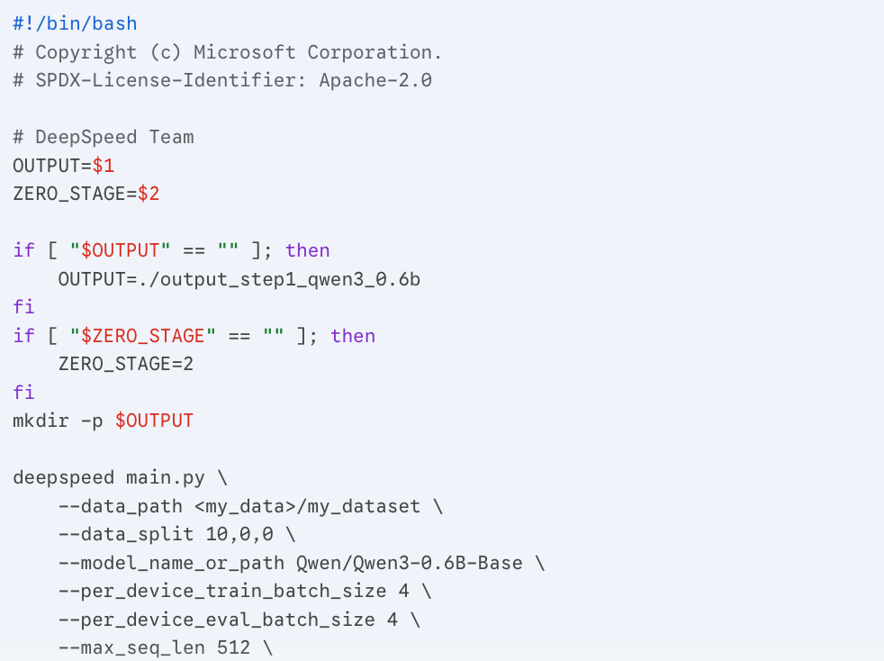
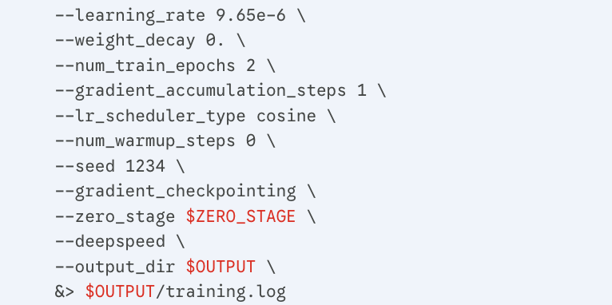
5.5 DeepSpeed-Chat: Modify the Script of Step 1
For step 1 SFT, modify the training/step1_supervised_finetuning/training_scripts/llama2/run_llama2_7b.sh to run_qwen3_0.6b.sh
Lecture 7

Slide 40
5.5. DeepSpeed-Chat: Training Step 1
# Run this from the 'training/step1_supervised_finetuning' directory. # This example demonstrates training on a node with 8 NVIDIA GPUs.
CUDA_VISIBLE_DEVICES=0,1,2,3,4,5,6,7 bash training_scripts/qwen/run_qwen3_0.6b.sh
1. Evaluation During Training
During training, periodic evaluations are performed to calculate Perplexity (PPL). An evaluation is triggered at the end of every epoch, and the PPL should gradually decrease as the model learns.
2. Model Inference & Chat Testing
Once training is complete, the chat.py script located in the DeepSpeed-Chat root directory can be used for interactive inference. Simply point the path parameter to the newly trained model's directory.
# Run this from the 'training/step1_supervised_finetuning' directory. # This example demonstrates training on a node with 8 NVIDIA 5090 GPUs.
CUDA_VISIBLE_DEVICES=0,1,2,3,4,5,6,7 bash training_scripts/qwen/run_qwen3_0.6b.sh
Lecture 7

Slide 41
Outline
5 The Life Cycle of Large Language Models
5.4 Data Construction
5.5 DeepSpeed-Chat SFT
5.6 Model Distillation
Lecture 1

Slide 42
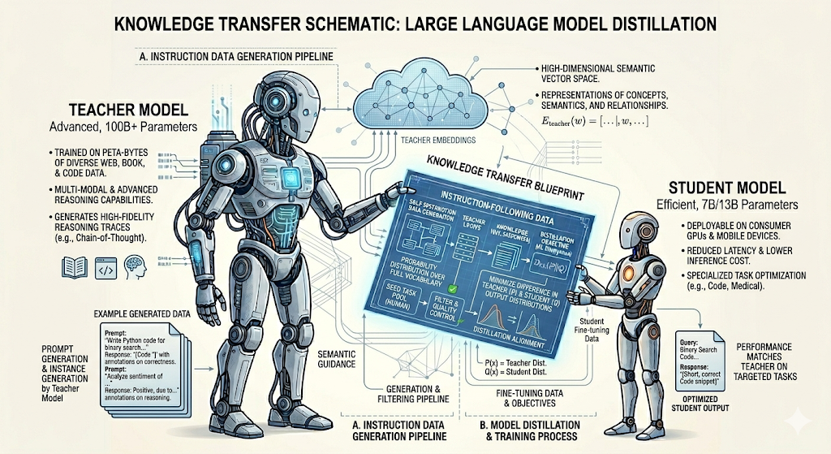
5.6 Model Distillation: Scaling Down Large Language Models
How AI teaches AI to be efficient.
Lecture 7

Slide 43
5.6 Model Distillation: The Problem with Supervised Fine-Tuning (SFT)
Base models need instruction data to become helpful assistants (SFT).
Manual data creation requires human experts writing prompts and answers.
The Bottleneck: This is incredibly slow, expensive, and difficult to scale.
Lecture 7

Slide 44
5.6 Model Distillation: Self-Instruct
What is Self-Instruction?
Instead of humans writing data, we use an advanced LLM to generate its own training data
The Goal: Automate the creation of diverse, high-quality instruction-following pairs
Change: from the human-curated paradigm to the AI-generated paradigm.
Representative work: Self-Instruct [1]
[1] Wang, Yizhong, et al. "Self-instruct: Aligning language models with self-generated instructions." Proceedings of the 61st annual meeting of the association for computational linguistics (volume 1: long papers). 2023.
Lecture 7

Slide 45
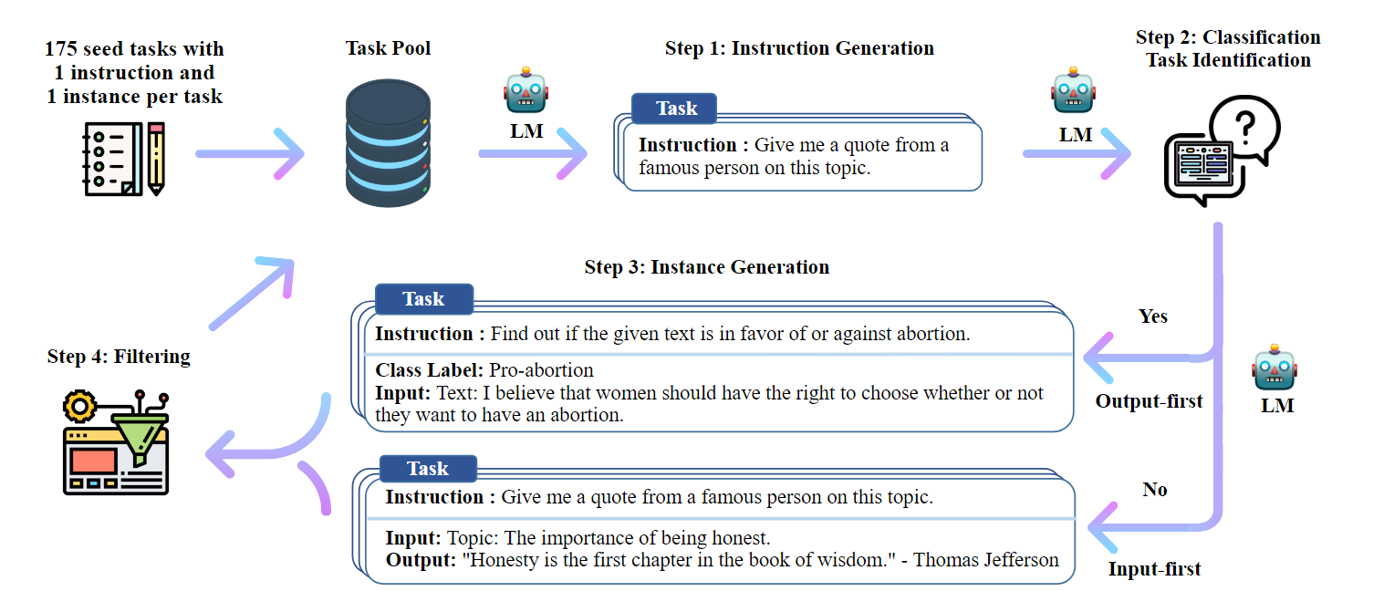
5.6 Self-Instruction
Manual construction of instruction data is costly and requires significant human effort. Consequently, some researchers have explored more efficient alternatives.
Self-Instruct leverages the generative capabilities of large language models to automatically construct instructions. The Self-Instruct data generation process is an iterative bootstrapping algorithm.
It consists of the following four steps:
Lecture 7

Slide 46
5.6 How Self-Instruct Works
Step 1: Task Instruction Generation
A small instruction dataset consisting of 175 tasks (pre-defined), referred to as the seed instruction set, is manually constructed to initialize the instruction pool.
The model then generates instructions for new tasks through a bootstrapping process: in each iteration, 8 task instructions are sampled from the instruction pool (comprising 6 human-written seed instructions and 2 instructions previously generated by the model).
These are concatenated as in-context examples to prompt the pre-trained language model, GPT-3, to generate additional task instructions. This process continues until the model ceases generation, reaches the maximum sequence length.
Lecture 7
Notes:
步骤1：生成任务指令 手动构建一个包含175 个任务的小型指令数据集，称为种子指令集，用于初始化指令池。然后让模型以自举（Bootstrapping）的方式，利用指令池，生成新任务的指令：每次从指令池中采样8 条任务指令（其中6 条来自人工编写的种子指令，2 条是模型迭代生成的），将其拼接为上下文示例，引导预训练语言模型GPT-3 生成更多的新任务的指令，直到模型自己停止生成，或达到模型长度限制，或是在单步中生成了过多示例（例如当出现了“Task 16”时）
1. Visualizing the "Seed" Concept Undergraduates often confuse "Pre-training" with "Instruction Tuning." Use a slide to explain that the Seed Set is the "spark" that ignites the automation process.
2. Explaining the 6:2 Ratio
Logic: Explain why the prompt uses 6 human seeds and 2 model-generated tasks.
Insight: This ratio maintains high quality (via human seeds) while introducing variety and "self-evolution" (via model-generated tasks). It prevents the model from drifting too far into nonsense while still expanding the task space.
3. Boundary Conditions (The "Task 16" Rule)
Logic: Explain that LLMs are prone to "repetition loops" or "hallucinations" when generating lists.
Insight: Setting a hard stop at a specific count (like Task 16) is a practical engineering heuristic to ensure the quality and diversity of the generated batch remains high.
4. Connecting to Distillation Frame this step as the Data Synthesis Phase. In the context of distillation, this is where the "Teacher" model (GPT-3 in this case) defines the curriculum that the "Student" model will eventually study.

Slide 47
5.6 Self-Instruction
Step 2: Identifying Classification Tasks
Since the subsequent processing methods differ for classification and non-classification tasks, this step requires determining whether an instruction represents a classification task.
This is achieved by using the same method of concatenating several in-context examples, allowing the model to automatically identify whether the task type is classification.
Lecture 7
Notes:
步骤2：确定指令是否代表分类任务由于后续对于分类任务和非分类任务有两种不同的处理方法，因此需要在本步骤对指令是否、为分类任务进行判断，同样是利用拼接几个上下文示例的方法让模型自动判断任务类型是否是分类。

Slide 48
5.6 Self-Instruction
Step 3: Generating Task Inputs and Outputs
While the language model has generated instructions for new tasks in Step 1, these instructions lack corresponding input-output pairs.
This step completes the instruction data by generating these components.
Following the previous methodology, this stage utilizes in-context learning: by providing the pre-trained model with prompts containing "Instruction," "Input," and "Output" examples from other tasks, the model can generate input-output pairs for the new task.
Depending on the task category, either an "Input-First" or "Output-First" approach is applied.
Lecture 7
Notes:
步骤3：生成任务输入和输出通过步骤1，语言模型已经生成了面向新任务的指令，然而指令数据中还没有相应的输入和输出。本步骤将为此前生成的指令生成输入和输出，让指令数据变得完整。与之前的步骤相同，本步骤同样使用语境学习，使用来自其他任务的“指令”“输入”“输出”上下文示例做提示，预训练模型就可以为新任务生成输入–输出对。针对不同的任务类别，分别使用“输入优先”或“输出优先”方法：对于非分类任务，使用输入优先的方法，先根据任务产生输入，然后根据任务指令和输入，生成输出；而对于分类任务，为了避免模型过多地生成某些特定类别的输入（而忽略其他的类别），使用输出优先的方法，即先产生所有可能的输出标签，再根据任务指令和输出，补充相应的输入。

Slide 49
5.6 Self-Instruction
Step 3: Generating Task Inputs and Outputs
While the language model has generated instructions for new tasks in Step 1, these instructions lack corresponding input-output pairs.
This step completes the instruction data by generating these components.
Following the previous methodology, this stage utilizes in-context learning: by providing the pre-trained model with prompts containing "Instruction," "Input," and "Output" examples from other tasks, the model can generate input-output pairs for the new task.
Depending on the task category, either an "Input-First" or "Output-First" approach is applied.
Lecture 7
Notes:
步骤3：生成任务输入和输出通过步骤1，语言模型已经生成了面向新任务的指令，然而指令数据中还没有相应的输入和输出。本步骤将为此前生成的指令生成输入和输出，让指令数据变得完整。与之前的步骤相同，本步骤同样使用语境学习，使用来自其他任务的“指令”“输入”“输出”上下文示例做提示，预训练模型就可以为新任务生成输入–输出对。针对不同的任务类别，分别使用“输入优先”或“输出优先”方法：对于非分类任务，使用输入优先的方法，先根据任务产生输入，然后根据任务指令和输入，生成输出；而对于分类任务，为了避免模型过多地生成某些特定类别的输入（而忽略其他的类别），使用输出优先的方法，即先产生所有可能的输出标签，再根据任务指令和输出，补充相应的输入。

Slide 50
5.6 Self-Instruction
Step 4: Filtering Low-Quality Data
To ensure data diversity, newly generated instruction data must be compared against the existing instruction pool before being added.
An instruction is only eligible for inclusion if its ROUGE-L similarity score with every instruction already in the pool is below 0.7.
Furthermore, to maintain high data quality, several heuristic rules are applied for filtering: instructions that are duplicates, excessively long or short, or contain specific invalid keywords (such as "image") are removed.
Lecture 7
Notes:
大家请看最后一步，这也是最体现“工程直觉”的一步。我们刚才辛苦生成的这些数据，其实并不能直接喂给学生模型。为什么？因为自动化生成必然会带来“噪声”。
ROUGE-L 的全称是 Recall-Oriented Understudy for Gisting Evaluation - Longest Common Subsequence。
它与基于 n-gram 的匹配方法（如 ROUGE-N）不同，其核心在于利用最长公共子序列 (LCS)。LCS 能够捕捉文本中词序的一致性，且不要求单词必须连续出现。
1. 为什么要用 ROUGE-L 查重？
首先，我们要解决多样性的问题。这里引入了一个指标叫 ROUGE-L，它通过计算“最长公共子序列”来衡量两条指令有多像。
为什么要设 $0.7$ 这个阈值？ 如果两条指令相似度超过 $0.7$，说明它们只是“换汤不换药”。
教学重点： 我们希望学生模型学习的是逻辑和概念，而不是死记硬背一些大同小异的垃圾话。如果数据太重复，模型就会产生“过拟合”，不仅浪费算力，还会变笨。
2. 启发式规则：识破 AI 的“一本正经胡说八道”
接着是启发式规则（Heuristic Rules）。大家记住，即使是 GPT-3 这样的顶级模型也会产生“幻觉”。
比如，一个纯文本模型可能会生成“请帮我修一下这张图”的指令。但在文本蒸馏中，这是无效的。
工程真相： 在工业界，自动化生成的数据往往有 $50\%$ 到 $80\%$ 会在这一步被无情丢弃。过滤，才是数据生产线的核心竞争力。
3. 回归本质：为蒸馏准备“黄金教材”
最后，我们来闭环整个逻辑。
Self-Instruct 就像是一座全自动化的印刷厂，在批量生产教科书。
而模型蒸馏（Distillation） 则是让学生模型去研读这些精挑细选后的“黄金教材”。
只有教材逻辑自洽、通俗易懂，几亿参数的小模型才能发挥出几千亿模型的效果。
（结尾提问，引导思考）
最后留给大家一个思考题：如果我们把 ROUGE-L 的阈值从 $0.7$ 放宽到 $0.9$，学生模型的效果会变好还是变差？

Slide 51
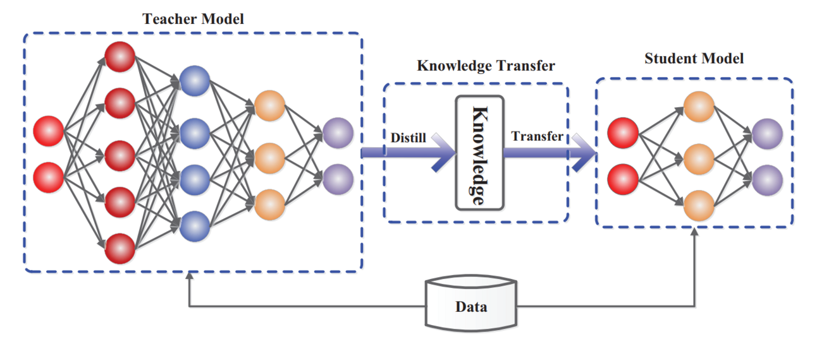
5.6 Knowledge Distillation
Definition: Transferring knowledge from a large, complex model to a smaller, faster one.
The Teacher: The massive, self-instructed model (High capability, slow, expensive).
The Student: A smaller base model (Lower capability initially, fast, cheap).
Image Credit: “Knowledge Distillation: A Survey” paper
Lecture 7

Slide 52
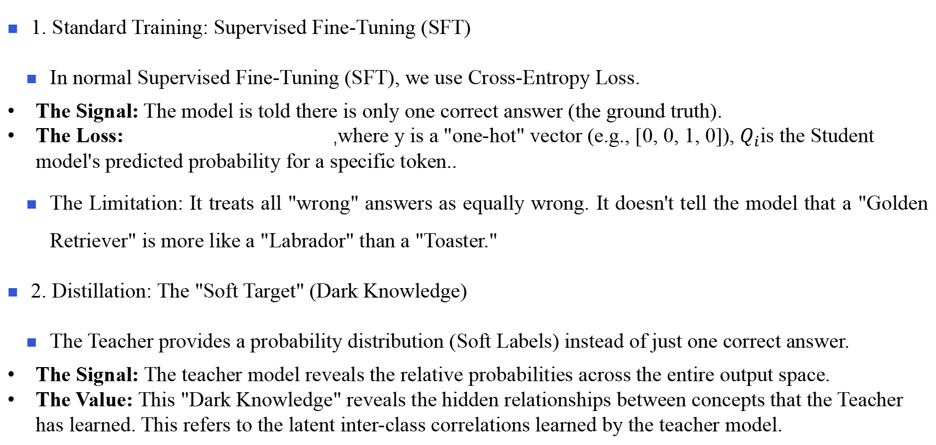
5.6 SFT vs. Distillation
1. Standard Training: Supervised Fine-Tuning (SFT)
In normal Supervised Fine-Tuning (SFT), we use Cross-Entropy Loss.
The Signal: The model is told there is only one correct answer (the ground truth).
The Loss: ,where y is a "one-hot" vector (e.g., [0, 0, 1, 0]), $Q_{i}$is the Student model's predicted probability for a specific token..
The Limitation: It treats all "wrong" answers as equally wrong. It doesn't tell the model that a "Golden Retriever" is more like a "Labrador" than a "Toaster."
2. Distillation: The "Soft Target" (Dark Knowledge)
The Teacher provides a probability distribution (Soft Labels) instead of just one correct answer.
The Signal: The teacher model reveals the relative probabilities across the entire output space.
The Value: This "Dark Knowledge" reveals the hidden relationships between concepts that the Teacher has learned. This refers to the latent inter-class correlations learned by the teacher model.
Lecture 7

Slide 53
5.6 The Math of Distillation
To make the Student's "brain" look like the Teacher's, we minimize the Kullback-Leibler (KL) Divergence:
Interpretation: This measures how much information is lost when we use the Student’s distribution to approximate the Teacher’s. When $D_{KL}$ = 0, the Student perfectly mimics the Teacher's logic.
Lecture 7

Slide 54
5.6 The Trick of Distillation
The "Temperature" (T) Trick:
Standard Softmax often makes the highest probability near 1.0 and others near 0.0, hiding the "Dark Knowledge." We use Temperature Scaling:
${, where q}_{i}$ is the resulting predicted probability for the i-th class between 0 and 1 and $z_{i}$is the raw logit.
Higher T: "Softens" the distribution, revealing the nuances between the "wrong" answers so the Student can learn from them more easily.
Lecture 7

Slide 55
End of Lecture 7
Lecture 7 2026/04/10

